Slide 1
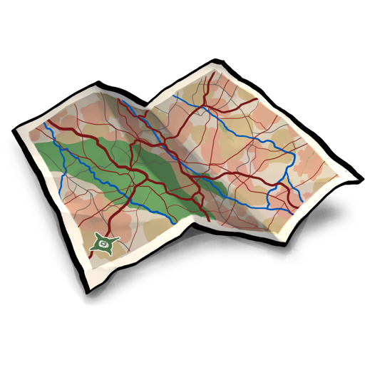






SceneGrok: Inferring Action Maps in 3D Environments
Manolis Savva, Angel X. Chang Pat Hanrahan, Matthew Fisher, Matthias Nießner
Computer Graphics Laboratory
Max Planck Center
for visual computing and communication

Slide 2
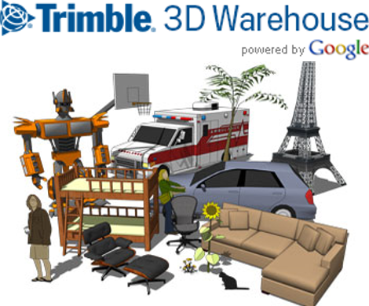
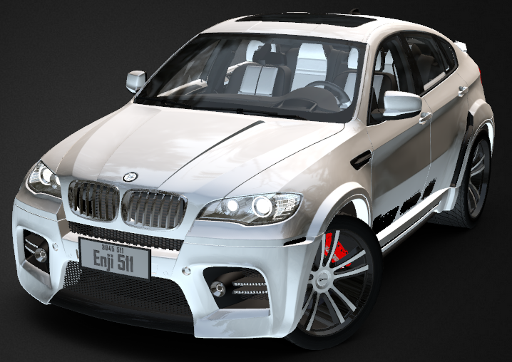

Motivation: a lot of geometry

Slide 3
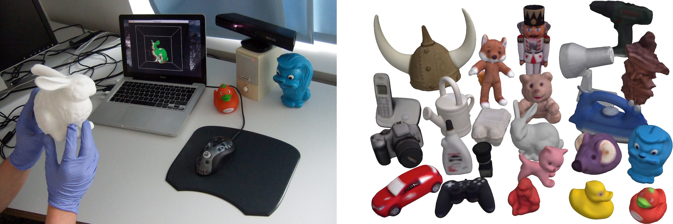
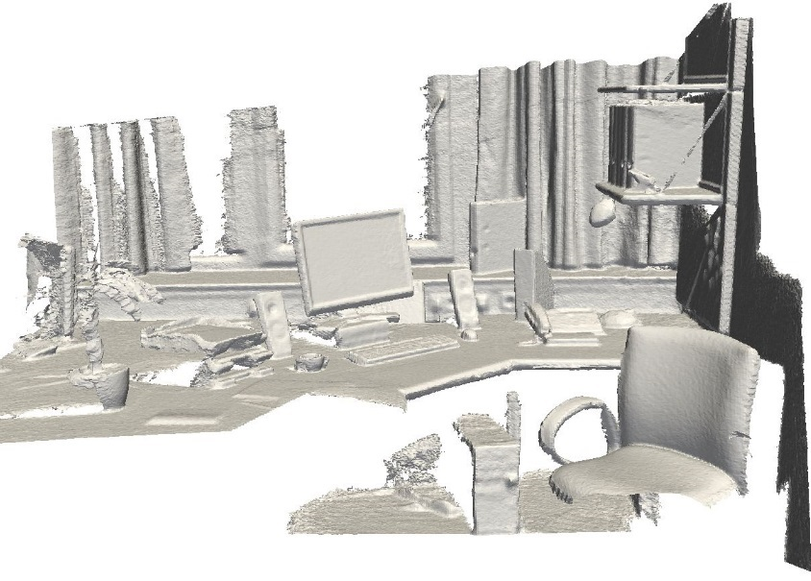
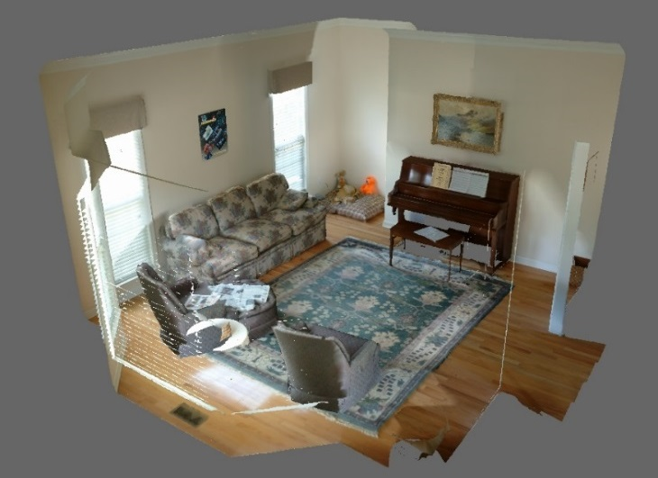
Motivation: a lot of geometry

Slide 4
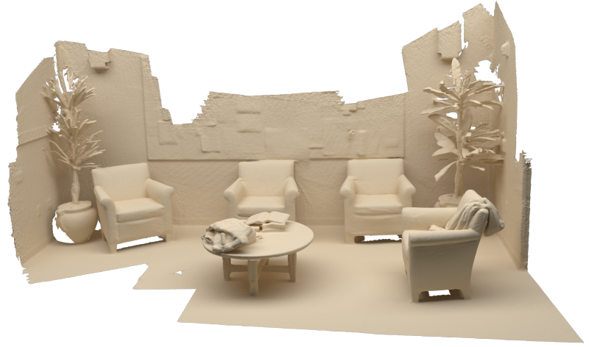
Problem: making sense of geometry
Voxel Hashing [Nießner et al. 13]

Slide 5
Our question: where can I do X?

Slide 6
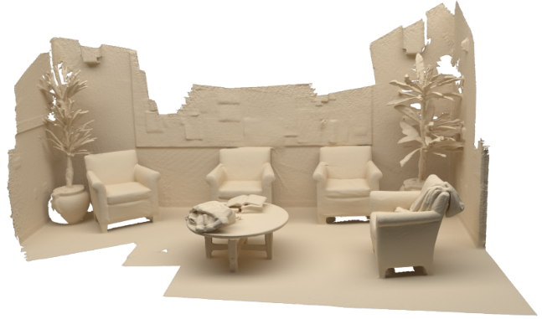



Action map
PDF over scene geometry
Likelihood of person performing action at position $x$
$$M_{sit}(x)$$
$$M_{read}(x)$$

Slide 7
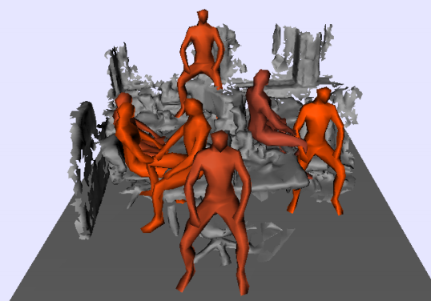
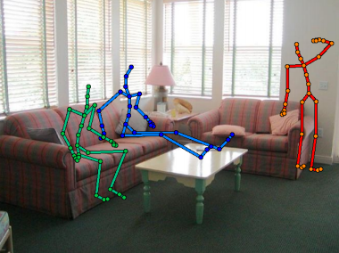
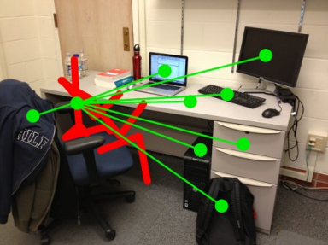
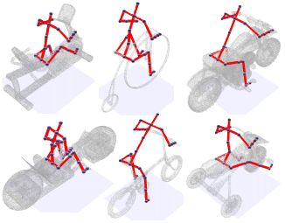
Related work
What makes a chair a chair? [Grabner et al. 2011]
From 3D Scene Geometry to Human Workspace [Gupta et al. 2012]
Hallucinating Humans [Jiang et al. 2013]
Shape2Pose [Kim et al. 2014]

Slide 8
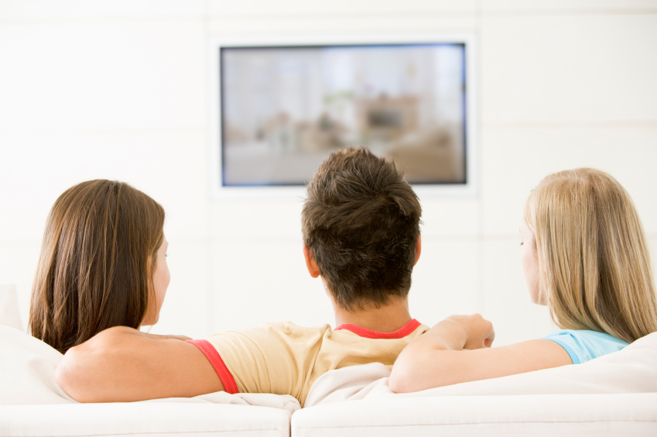
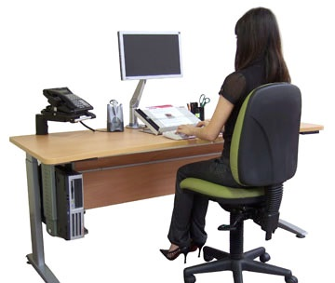

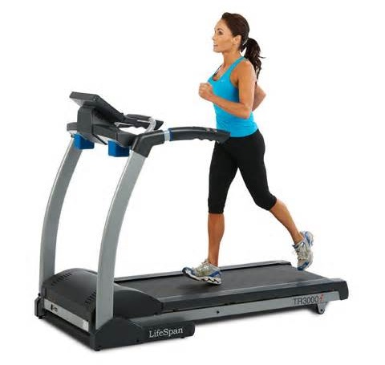
Insight: observe natural behavior

Slide 9
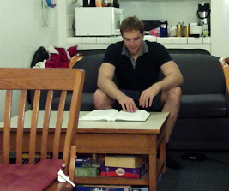
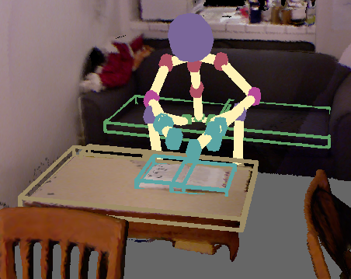
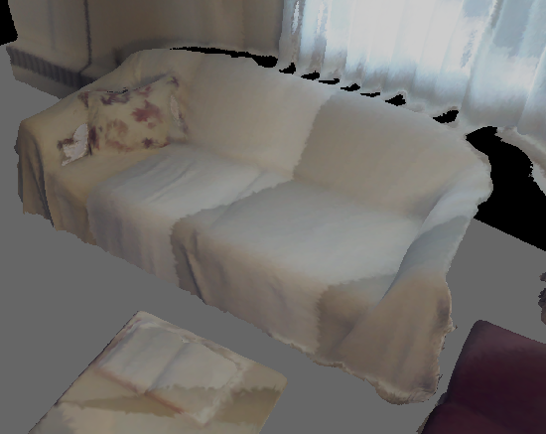
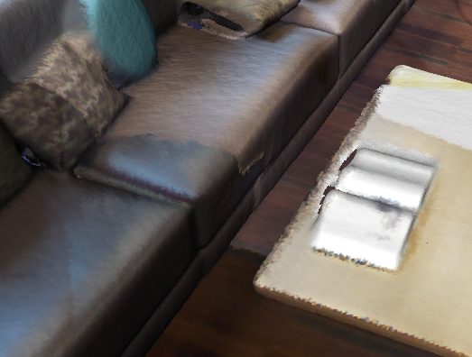
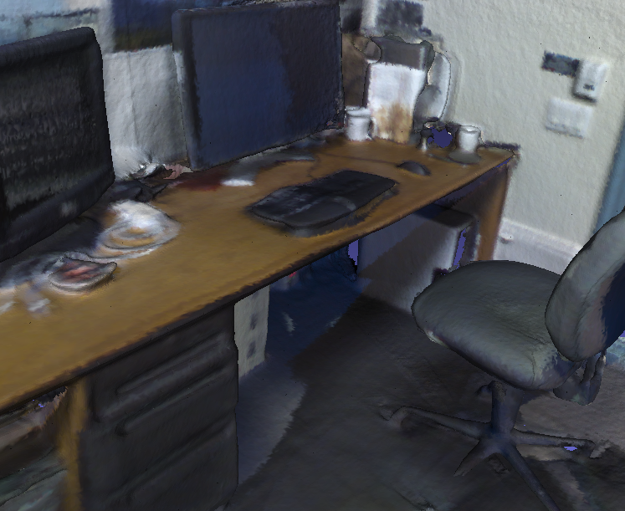
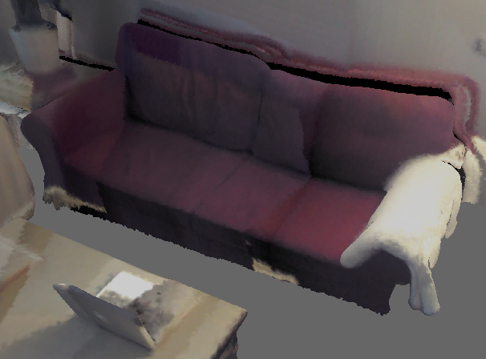
Approach overview
Observing
Learning
Predicting

Slide 10
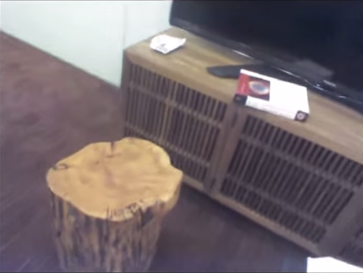
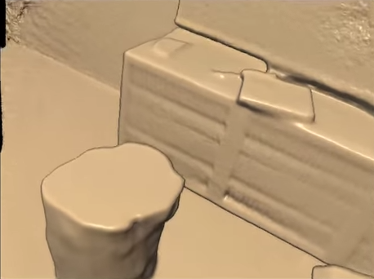
Approach overview: observing
RGB-D Scan
RGB-D Scan

Slide 11
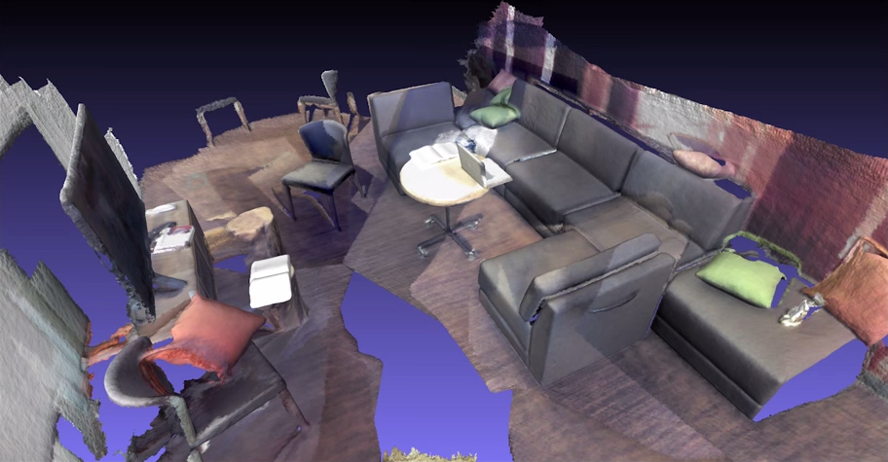
Approach overview: observing
Reconstruct
Voxel Hashing [Nießner et al. 13]
RGB-D Scan
Reconstruct

Slide 12
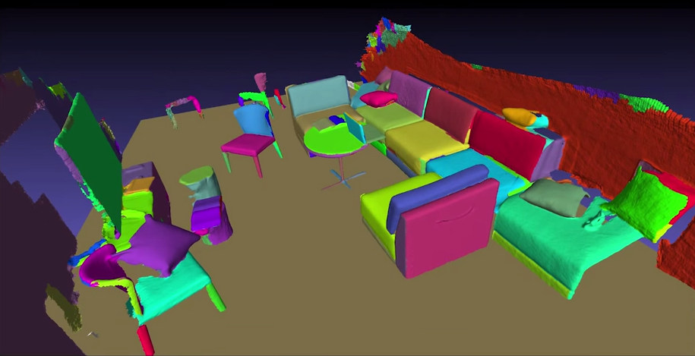
Approach overview: observing
Segment
Graph-based Segmentation [Felzenszwalb 04]
RGB-D Scan
Reconstruct
Segment

Slide 13
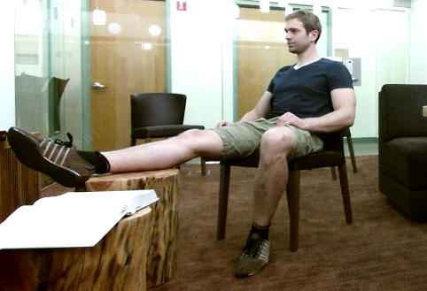
Approach overview: observing
Observe
RGB-D Scan
Reconstruct
Segment
Observe

Slide 14
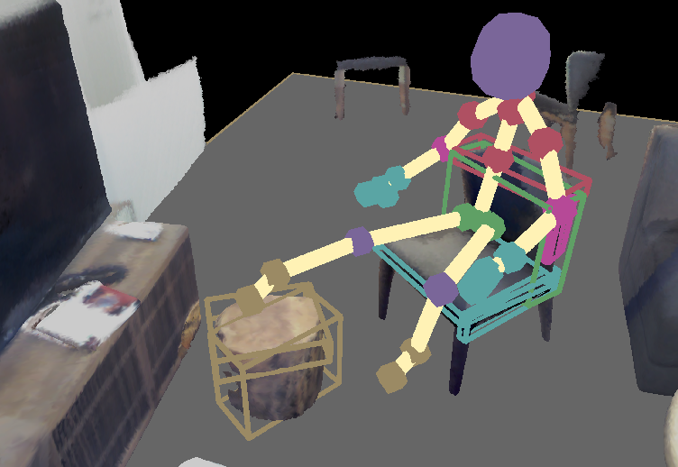
Approach overview: observing
Activate
RGB-D Scan
Reconstruct
Segment
Observe
Activate

Slide 15
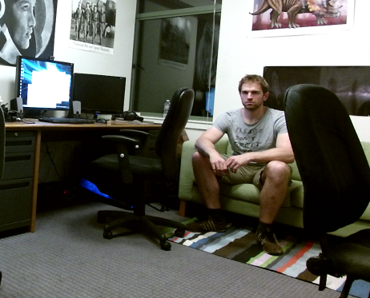
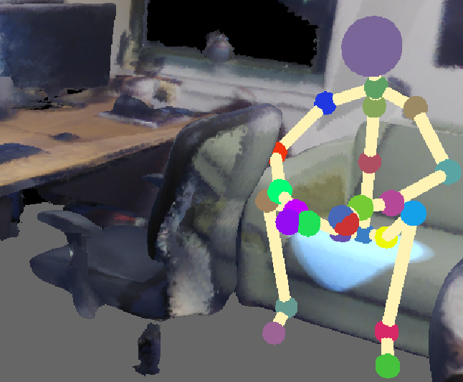
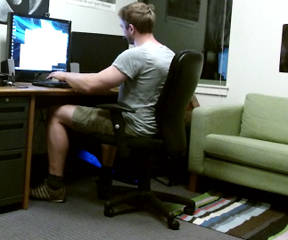
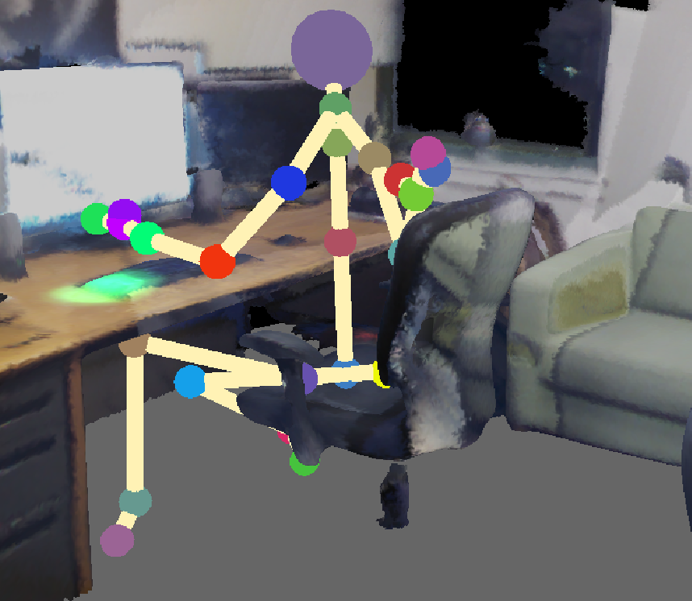
Annotating action observations
Observation
Pose in 3D scene
Action annotation
t = [00:05, 00:30]
“sitting”
t = [00:42, 02:15]
“sitting” + “using-PC”

Slide 16
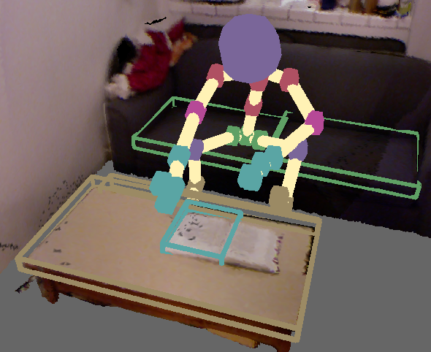


Approach overview: learning
Region features $∈ℝ^{5}$
$$\left[\begin{aligned}\begin{aligned}\begin{matrix}{\text{p}}_{z} \\ {\text{h}}_{z} \\ {\text{d}}_{xy}\end{matrix} \\ {\text{a}}_{xy}\end{aligned} \\ {\text{n}}_{z}\end{aligned}\right]=\left[\begin{aligned}\begin{aligned}\begin{matrix}0.50m \\ 0.05m \\ 0.35m\end{matrix} \\ 0.25m\end{aligned} \\ 0.95\end{aligned}\right]$$
$$M_{a}\left(x\right)=\int_{p}{P_{a}(x,p)}$$
classifier

Slide 17
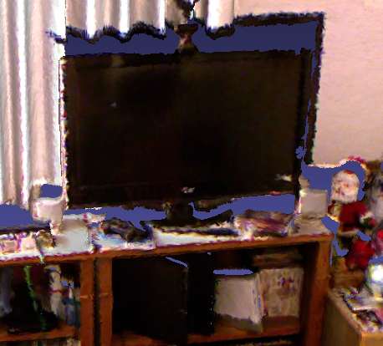
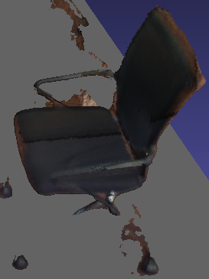
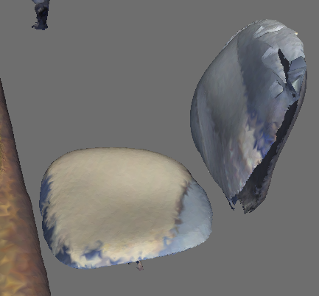
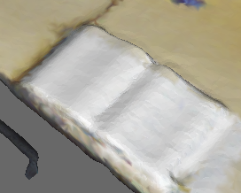
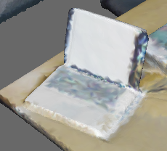
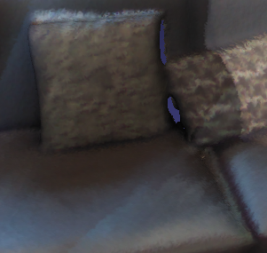






Region codebook
$$c_{0}$$
$$c_{2}$$
$$c_{1}$$
$$c_{5}$$
$$c_{3}$$
$$c_{4}$$
Similar to unsupervised feature learning for images [Coates and Ng 2012] [Savva et al. 2012]

Slide 18
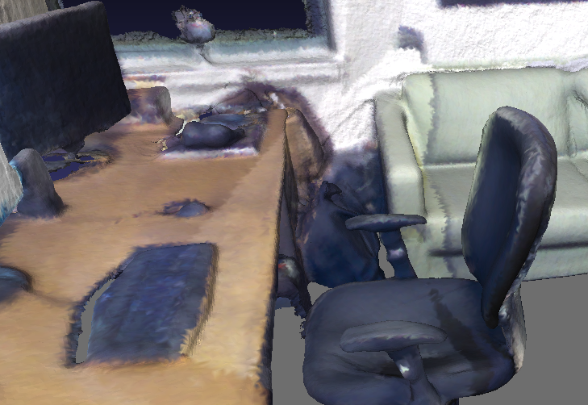
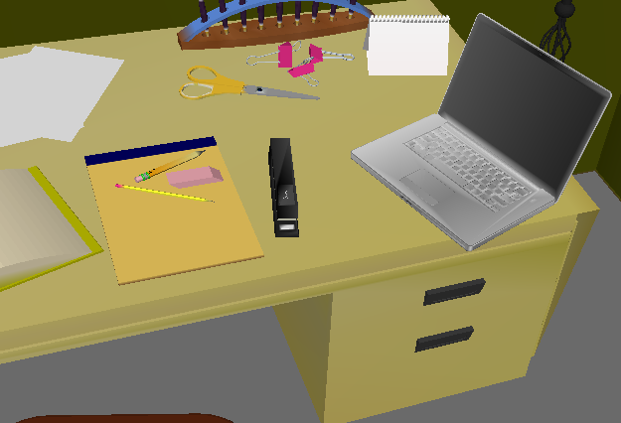



























Codebook encoding
$$c_{1}$$
region $k$-means → codebook $𝓓∈ℝ^{5×k}$
$$c_{0}$$
$$c_{2}$$
$$c_{5}$$
$$c_{3}$$
$$c_{4}$$
$$max(0,𝓓^{T}s_{0}−α_{0})$$
$$α_{0}$$
$$c_{0}$$
$$c_{1}$$
$$c_{2}$$
$$c_{3}$$
$$c_{4}$$
$$c_{5}$$
$$s_{0}∈ℝ^{5}$$
$$𝓓^{T}s_{0}∈ℝ^{k}$$
$α_{1}$
$$max(0,𝓓^{T}s_{0}−α_{1})$$
$$c_{0}$$
$$c_{1}$$
$$c_{2}$$
$$c_{3}$$
$$c_{4}$$
$$c_{5}$$
$$s_{1}∈ℝ^{5}$$
$$𝓓^{T}s_{1}∈ℝ^{k}$$

Slide 19
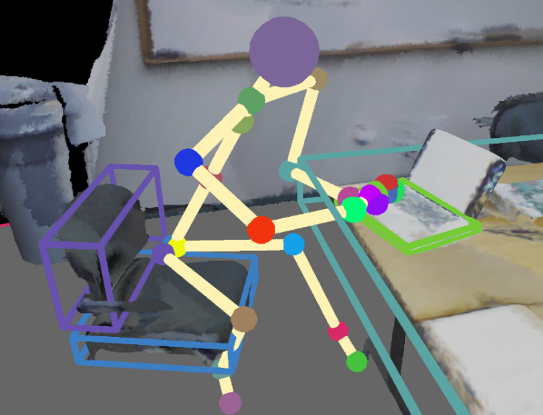




Learning: action classifier
Region response at location $x$and pose $p$ $$z(x,p)∈ℝ^{k}$$
Action label $a$
$$M_{a}\left(x\right)=\int_{p}{P_{a}(x,p)}$$
$$L_{a}(z(x,p))$$

Slide 20
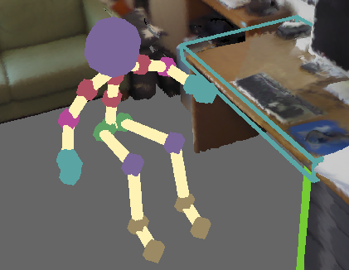
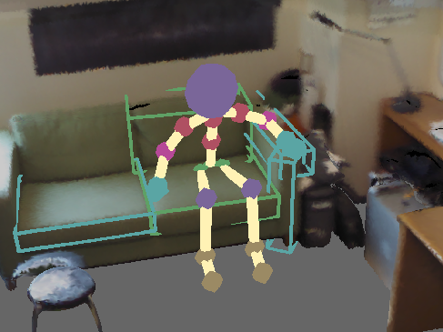
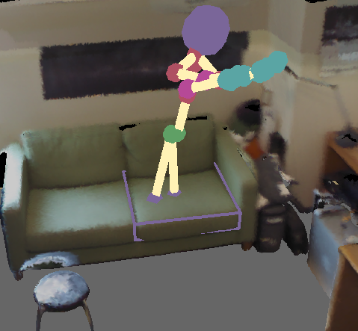
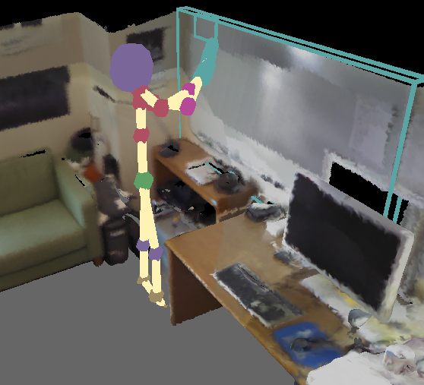
Approach overview: predicting action maps

Slide 21
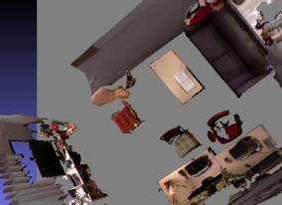
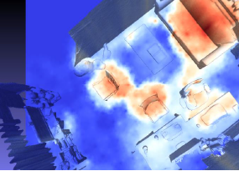
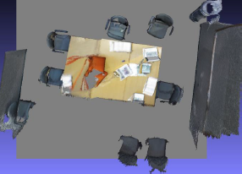
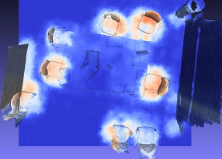
Predictions
“sitting in furniture”

Slide 22
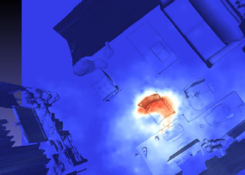

Predictions
“using desktop PC”

Slide 23


Predictions
“writing on whiteboard”

Slide 24




Predictions
“sitting in furniture”
Scenes from [Fisher et al. 12]

Slide 25


Predictions
“using desktop PC”
Scenes from [Fisher et al. 12]

Slide 26


Predictions
“using laptop”
Scenes from [Fisher et al. 12]

Slide 27

Evaluation: ground truth from people
“using desktop PC”

Slide 28


Evaluation: ground truth comparison
“sitting in furniture”
“watching TV”

Slide 29








Action maps for scene similarity?
$$\int{M_{sit}}$$
$$\int{M_{read}}$$
$$\int{M_{walk}}$$
$$∈ℝ^{k}$$
?
$$\int{M_{sleep}}$$
$$⋮$$
Action-based scene descriptor

Slide 30



Action maps for scene similarity
Query scene
Retrieved scenes

Slide 31



Action maps for scene similarity
Query scene
Retrieved scenes

Slide 32



Future work: dynamics and moving objects
Sitting down? Getting up?
Where is the marker?

Slide 33


Future work: functional scene reconstruction
Action map predictions
Geometric Prior
Activity Prior
Functional reconstruction

Slide 34
Summary
Action maps: action likelihood in 3D scenes
Learn action – geometry correlation from observations
Predict action maps in 3D reconstructions + virtual scenes
Applications
Scene similarity / retrieval
Functional scene reconstruction

Slide 35

Thank you!
http://bit.ly/scenegrok

